Slide 1

Heart Disease Analysis
By Aniket Jamdade

Slide 2
Introduction
The heart disease dataset contains patient information aimed at diagnosing heart conditions. It includes demographic data, clinical measurements, and test results. By analyzing this data, researchers can identify patterns and risk factors associated with heart disease. The dataset helps in understanding the prevalence of heart disease across different age groups, with a higher occurrence typically seen in middle-aged and elderly individuals.

Slide 3
Details of the Data
The heart disease dataset consists of various patient features that aid in diagnosing and evaluating heart conditions. It includes data on age, gender, types of chest pain, resting blood pressure, cholesterol levels, fasting blood sugar, resting electrocardiographic results, maximum heart rate achieved, exercise-induced angina, ST depression, slope of the peak exercise ST segment, number of major vessels colored by fluoroscopy, and thalassemia status. This comprehensive dataset helps identify factors contributing to heart disease, which typically occurs more frequently in middle-aged and elderly individuals.

Slide 4
Important KPIs
Total Count of Individuals having Heart diseases
Average Resting Blood Pressure (Blood Pressure when an individual is Resting)
Average Cholesterol
Average Maximum Heart rate: Heart Rate when an individual is doing vigorous exercise

Slide 5
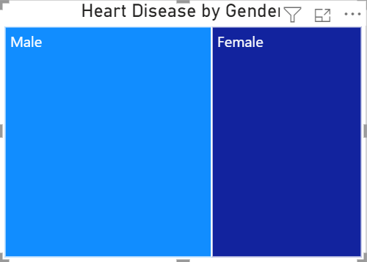
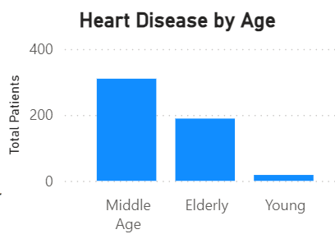
Insights
What kind of Demographics we have:
Males suffer from heart disease more than females although its just a sample
Middle Age seem to spot to have high likelihood of having heart diseases

Slide 6
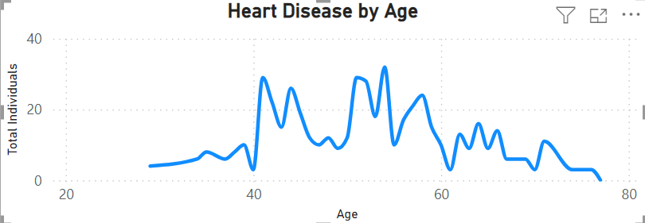
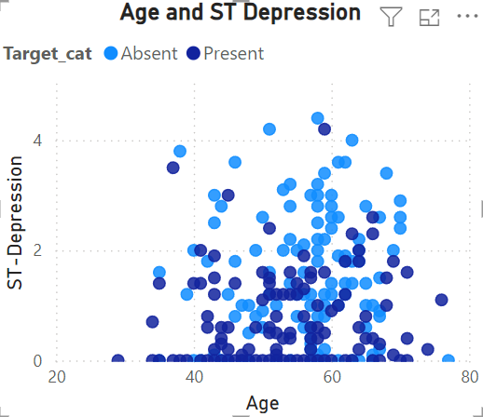
Disease By Age
It's interesting to note that the risk of heart disease typically increases with age, peaking around 40-60 years old, and then decreases for elderly individuals over 60. Similarly, ST depression, which can be a sign of heart problems, shows that below 2 is mostly indicative of having Heart Disease.

Slide 7
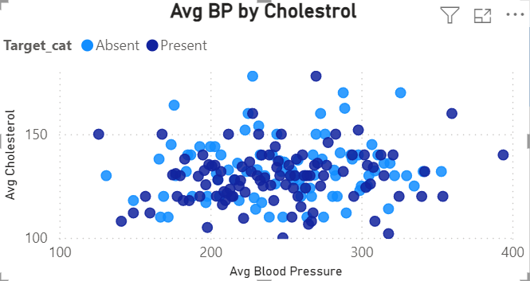
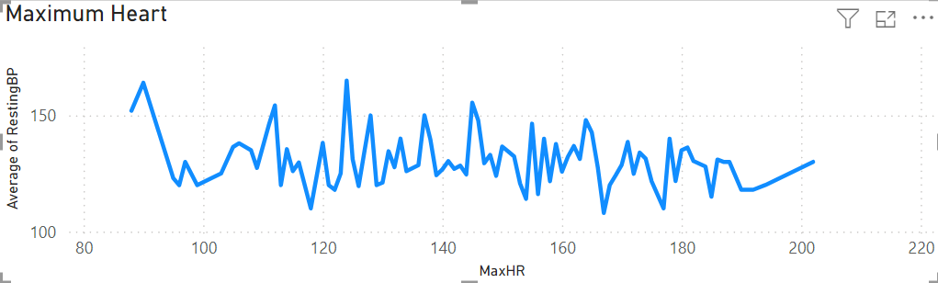
Deeper Insights
Cholesterol and blood pressure often show a positive correlation, where higher blood pressure tends to be associated with higher cholesterol levels. But there is no significant difference whether an individual has a heart disease or not, although between 120-130 is a spot to see the significance.
Additionally, there's typically a downward trend in maximum heart rate with resting blood pressure. However, there can be spikes in maximum heart rate readings, particularly between 120-130 beats per minute, which might indicate the presence of heart disease in individuals.

Slide 8
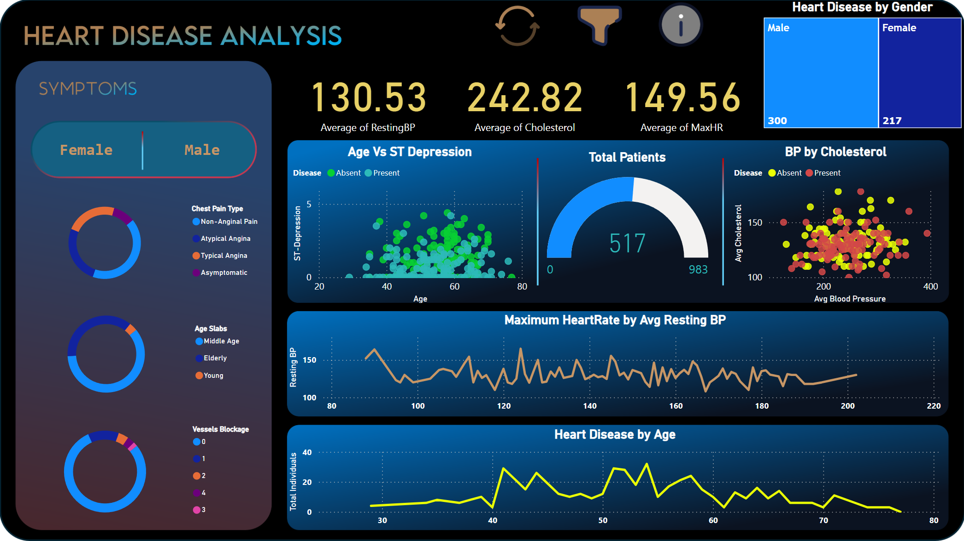
My Design
Link to Report

Slide 9
Thank you

